Slide 1

SRM INSTITUTE OF SCIENCE AND TECHNOLOGY
SCHOOL OF COMPUTING
DEPARTMENT OF COMPUTING TECHNOLOGIES
18CSP109L / 18CSP111L - MAJOR PROJECT / INTERNSHIP
STUDENT ENGAGEMENT MEASUREMENT IN E-LEARNING SYSTEMS
BATCH NO : NW086
TEAM :
Om Rajput (RA1911032010028)
Suyash Nigam (RA1911032010027)
Project Guide :
Dr. TYJ Naga Malleswari

Slide 2
Table of Contents
Abstract
Introduction
Motivation
Literature Review
Challenges to Address
Comparison with existing methods
Innovations and Idea
Implementation and Scope
UML Diagrams of proposed modules
Algorithms Used
Output Screenshots and Demo
Conclusion and Future Enhancements

Slide 3
ABSTRACT
Online students participate in a variety of educational pursuits, including reading, writing, viewing instructional videos, taking online exams, and participating in online meetings.
While taking part in these educational activities, they exhibit a wide range of levels of interest, including boredom, aggravation, delight, indifferent, confusion, and learning gain.
In order to provide the online students with individualised pedagogical support through interventions, online educators need to precisely and efficiently identify the level of engagement their online students currently possess.
In the context of online education, this study gives an overview of the most recent developments in the field of engagement detection.

Slide 4
INTRODUCTION
With the rise of technology, virtual meetings have become a popular method of communication for people in different locations.
Virtual meetings use video conferencing technology to allow participants to communicate and collaborate remotely in real-time. This has become especially important in the wake of the COVID-19 pandemic, as many people have had to work and communicate from home.
While virtual meetings may seem very different from traditional in-person conferences, they share a common goal: bringing people together in a special meeting room.
In an in-person conference, everyone is physically present in the same room, whereas in a virtual meeting, participants can be located anywhere in the world as long as they have an internet connection.

Slide 5
MOTIVATION
One of the key benefits of virtual meetings is that they allow for more flexible and efficient communication. Participants can join the meeting from their own location, without the need to travel.
This saves time and money, as well as reducing the environmental impact of travel. Additionally, virtual meetings can be scheduled more easily, as participants don't need to factor in travel time.
Virtual meetings can also be recorded, allowing participants to review the meeting at a later time or share it with others who were unable to attend.
This is especially useful for training sessions or presentations where participants may want to refer back to the material later.

Slide 6
Literature Review
S/No | Paper Title | Author | Year | Journal | Ranking Criterion
 |  |  |  |  | Broad Domain | Existing Systems Addressed | Drawback/Flaws | Problem Addressed | Algorithms/ Tools/ Techniques Used
1 | A survey on: Facial Emotion Recognition and Classification | Manoj Moolchandani; Shivangi Dwivedi; Samarth Nigam; Kapil Gupta | 2021 | IEEE | Image classification | Emotion Detection using computer vision | Misclassified disgust and neutral mood | Face Localization Feature Extraction | CNN
2 | An Integrated Vision System on Emotion Understanding and Identity Confirmation | Yang-Yen Ou; An-Chao Tsai; Jhing-Fa Wang; Po-Chien Lin | 2018 | IEEE | Computer Vision | Emotion Detection using computer vision | Required data for training and subsequent identification is too complicated. | Person identification by posture and facial identifiers. | CNN

Slide 7
S/No | Paper Title | Author | Year | Journal | Ranking Criterion
 |  |  |  |  | Broad Domain | Existing Systems Addressed | Drawback/Flaws | Problem Addressed | Algorithms/ Tools/ Techniques Used
3 | Computer Vision for Attendance and Emotion Analysis in School Settings | Sarah Deniz; Dakyung Lee; Grace Kurian; Lourdes Altamirano; Darren Yee | 2019 | IEEE | Computer Vision | Emotion Detection using computer vision | Requires perfectly aligned cameras for proper data capture. | Can do face detection, face recognition, and emotion analysis | CNN
4 | Neutral Face Classification Using Personalized Appearance Models for Fast and Robust Emotion Detection | Pojala Chiranjeevi; Viswanath Gopalakrishnan; Pratibha Moogi | 2015 | IEEE | Computer Vision | Emotion Detection using computer vision | Required data for training and subsequent identification is too complicated. | Reduced model size to work on mobile devices and tablets. | CNN

Slide 8
Challenges To Address
Due to low Bandwidth issues :
The video is not visible
voice breakage
Infrastructure Issues : The need for a computer, adequate software, constant electricity and high-bandwidth internet is quite a big demand.
Electricity : Many parts of India still have low electricity supply

Slide 9
Comparison of Existing methods with merits and demerits
Research Paper | Merit | Demerit
A survey on: Facial Emotion Recognition and Classification | Face Localization Feature Extraction | Misclassified disgust and neutral mood
An Integrated Vision System on Emotion Understanding and Identity Confirmation | Person identification by posture and facial identifiers. | Required data for training and subsequent identification is too complicated.
Computer Vision for Attendance and Emotion Analysis in School Settings | Can do face detection, face recognition, and emotion analysis | Requires perfectly aligned cameras for proper data capture.
Neutral Face Classification Using Personalized Appearance Models for Fast and Robust Emotion Detection | Reduced model size to work on mobile devices and tablets. | Required data for training and subsequent identification is too complicated.

Slide 10
Comparison of Existing methods with merits and demerits
The task is to implement an online meeting application with a student interactivity measurement feature.
The objectives of this project includes -
A meeting platform for students as well as business professionals.
Participant interactivity measurement for the host.
Detailed focus analysis dashboard for the host.
Using ML model platform is able to detect whether the attendees are engaged in meet or not.

Slide 11
INNOVATION AND IDEA
Using machine learning and deep learning in a meeting platform can bring several innovations and ideas to improve the user experience. Here are a few possible examples:
Automatic transcriptions and summaries: The platform can recognize who is speaking and provide a transcript of the conversation. This can help participants to stay more engaged during the meeting and improve their comprehension.
Intelligent scheduling and agenda planning: Machine learning algorithms can analyze participants' schedules and preferences to suggest the best time and duration for the meeting.
Real-time feedback and sentiment analysis: Machine learning models can analyze participants' voices and body language to provide real-time feedback on their engagement and sentiment.
And many more….

Slide 12
SCOPE AND APPLICATION
The application can have various creative application.
Some of them are:
Improved learning outcomes
Personal feedback provision
Identifying at-risk students
Student engagement research

Slide 13
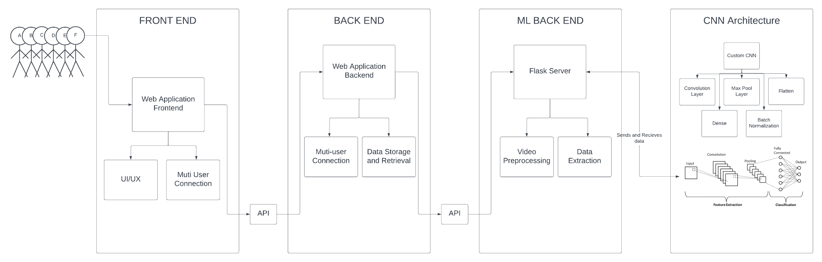
Architecture diagram of modules

Slide 14
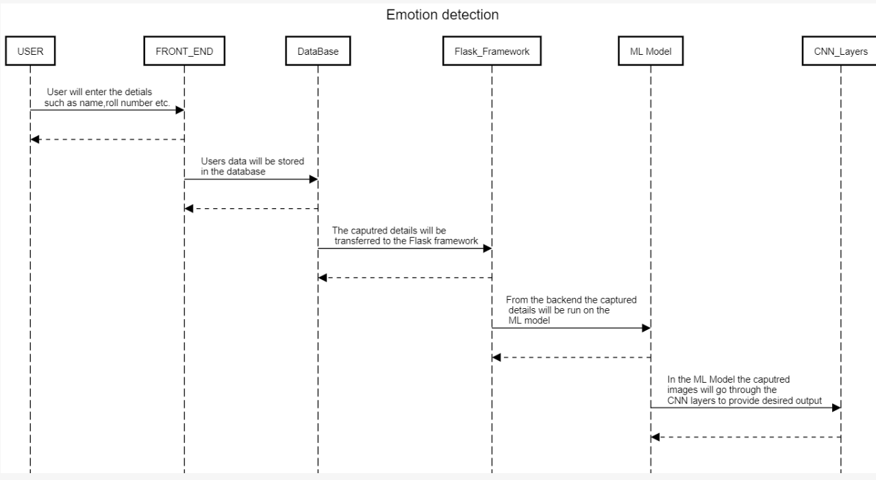
Sequence Diagram

Slide 15
Algorithms used
CNN (Convolution Neural Network) - used for Image processing and emotion detection
Using Feature Extraction, to transform raw pixels to numerical features.
Among many classification techniques, some that we used include KNN, Logistic regression, naive bayes among other names.

Slide 16

Meet Platform Screenshots

Slide 17
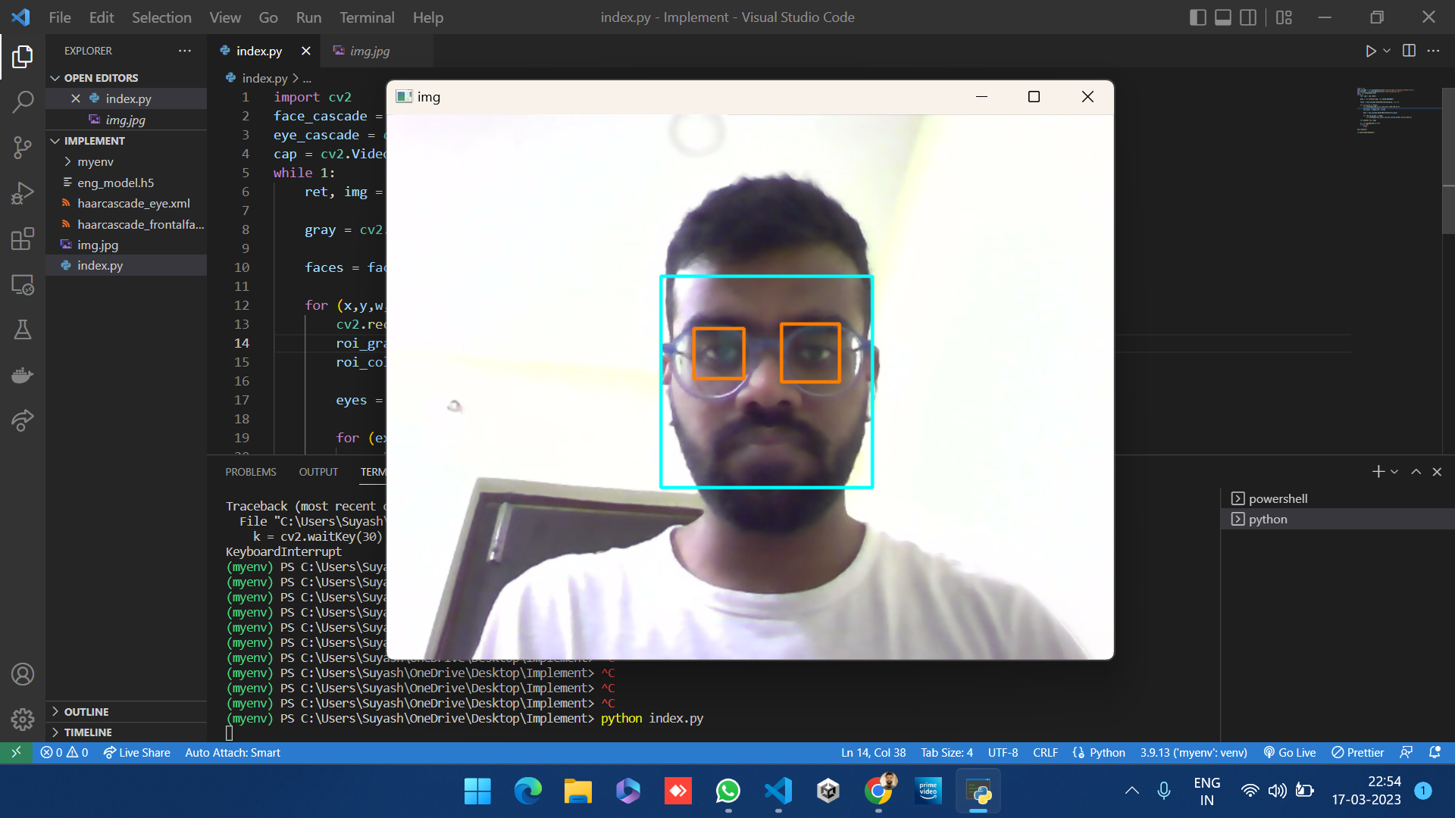
Meet Platform Screenshots

Slide 18
CONCLUSION and
FUTURE ENHANCEMENTS
The project developed with deep learning model and a web application to detect the engagement level of students in online meetings.
Future enhancements will include:
Expand emotions
Improve accuracy
Real-time recognition integration
Increased meet features
upgraded server

Slide 19
Thank You

